Slide 1
GEOM20013: WEEK 1 TUTORIAL WELCOME!

Slide 2
Your Tutors
Chris Lambert
Tutored last 3 years
Working as Surveyor and GIS analyst at Jacobs Engineering
Hazel Altundal
Final year Master of Engineering (Spatial Student)
Working as a surveyor at Heading & Associates

Slide 3

Icebreaker

Slide 4
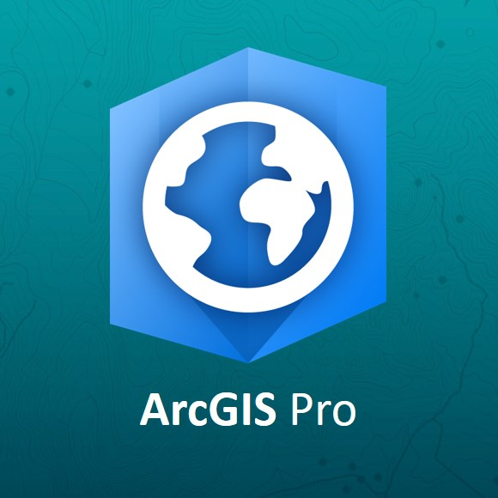


What is GIS?
Geographic Information System (GIS)
Is an immersive geographic database that supports the storing, analysis and presentation of spatial information
It is a system for making maps but also more that just making maps

Slide 5
Uses in industry and society
Disaster Management
Vic Emergency App
Risk analysis (Last Assignment)
City and Town Planning
New developments
Population analysis (Assignment 2)
Engineering
Asset management
Infrastructure planning (Assignment 3)
Transport analysis
Geology
Environmental management
Agriculture
Marketing and business
Property markets
Crime mapping
Tourism
Logistics
Fleet planning

Slide 6
Bring a USB
Bring a USB
BRING A USB or HDD, PLZ!!!!!
At least 32GB

Slide 7
How do the tutorials work?
Demonstrations
Each tutorial will consist of a 10 – 30 minute demonstration
These are essential to the assignments as they are about teaching the tools in ArcGIS Pro that you will need for the assignments
The rest of the time is allocated for the assignments
Ask us questions, we are here to help!

Slide 8
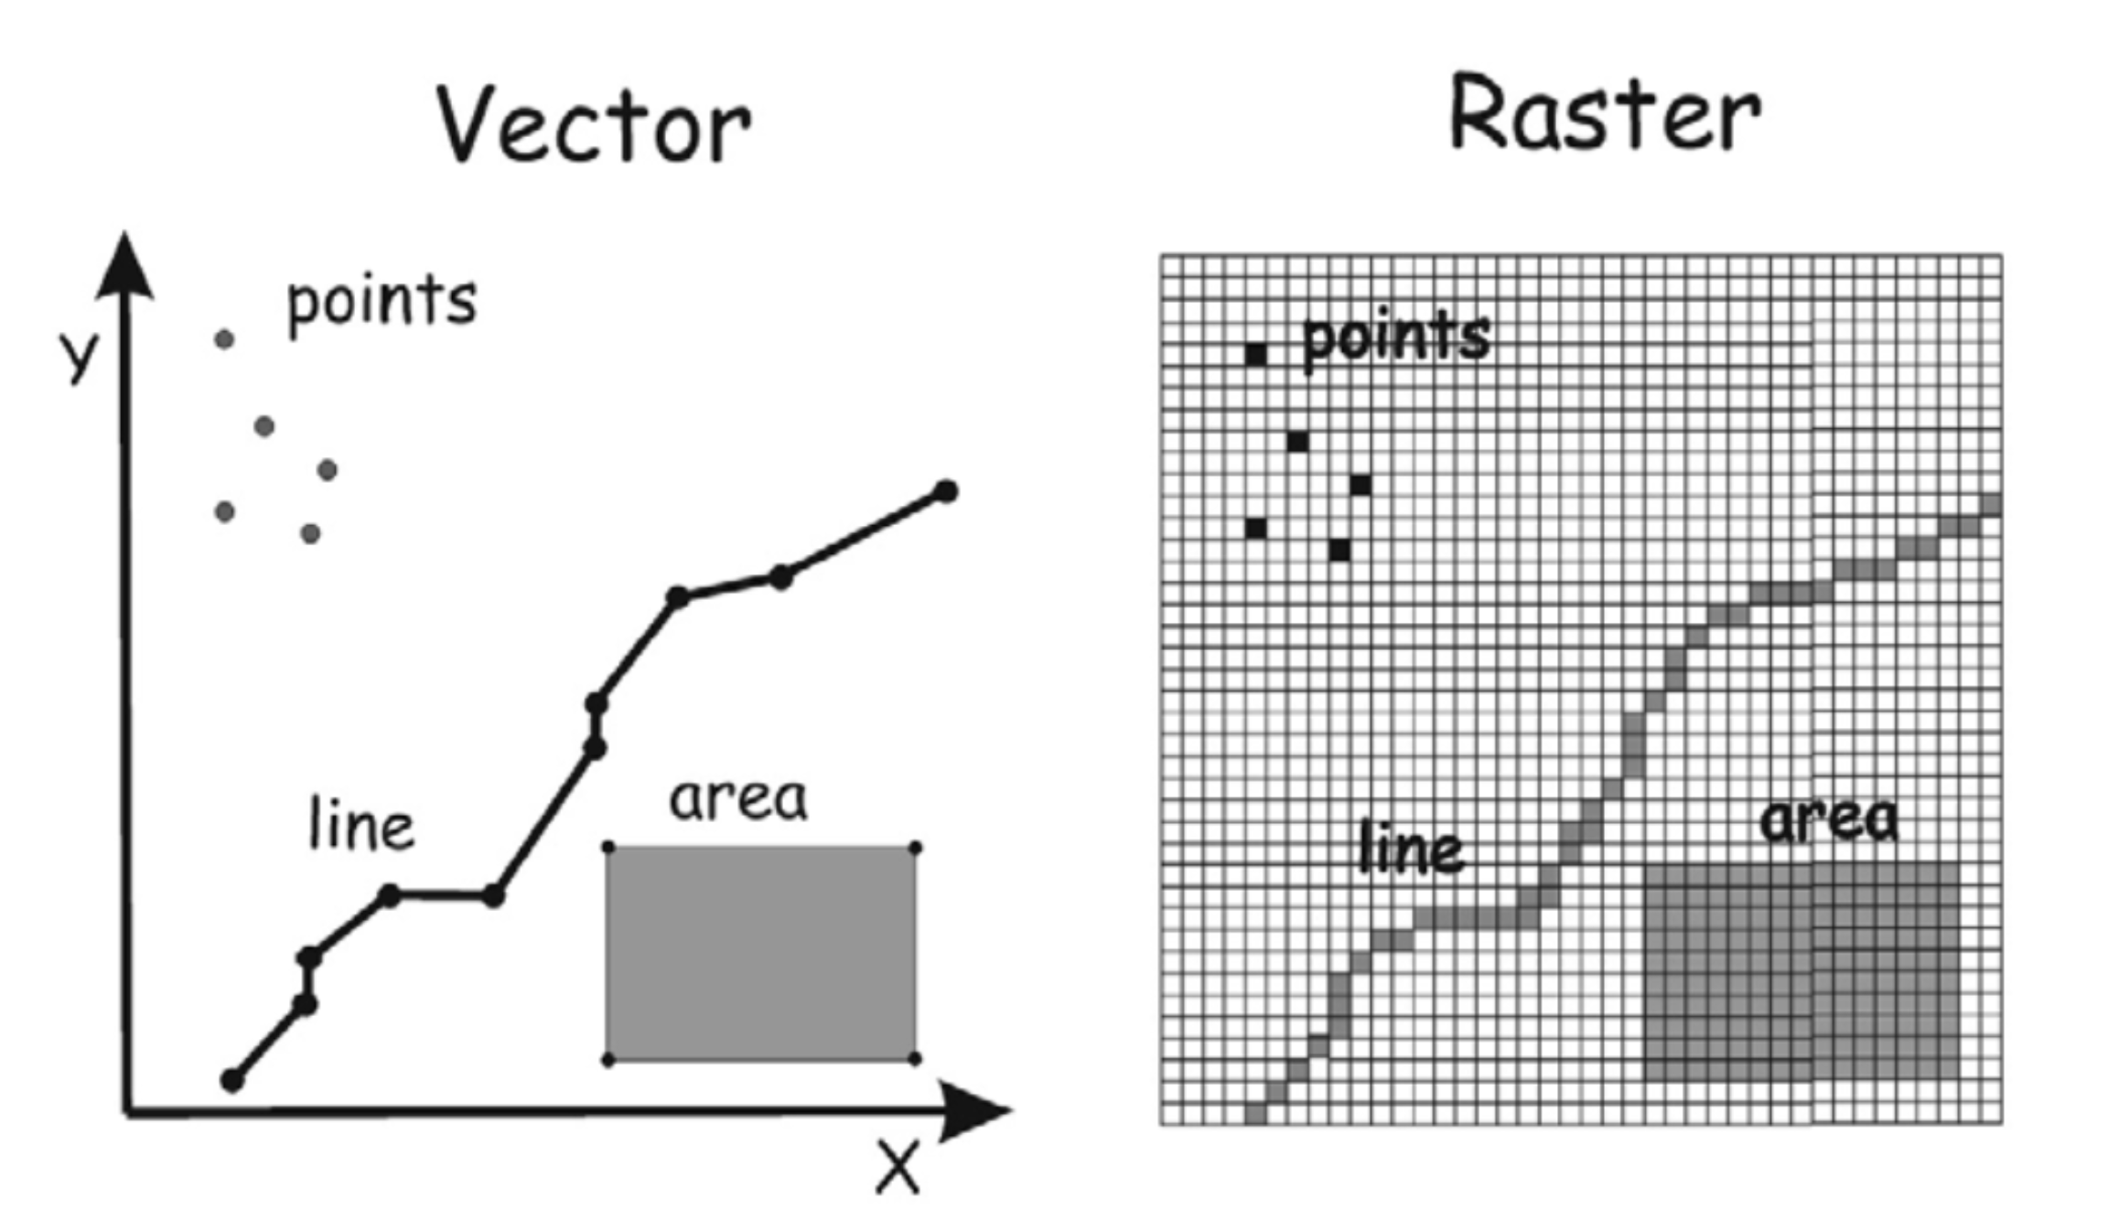
Things you need to know
Data Types

Slide 9
Things you need to know
Makings of a Map
Border
Orientation
Legend
Title
Scale

Slide 10
Assignments
Get to know ArcGIS 10%
Sunday, March 22nd 2020, 11:59pm (first 3 core modules) Sunday, March 29th 2020, 11:59pm (remaining modules)
Census GIS 10%
Decision Making in GIS 15%
Disaster Management GIS 30%

Slide 11
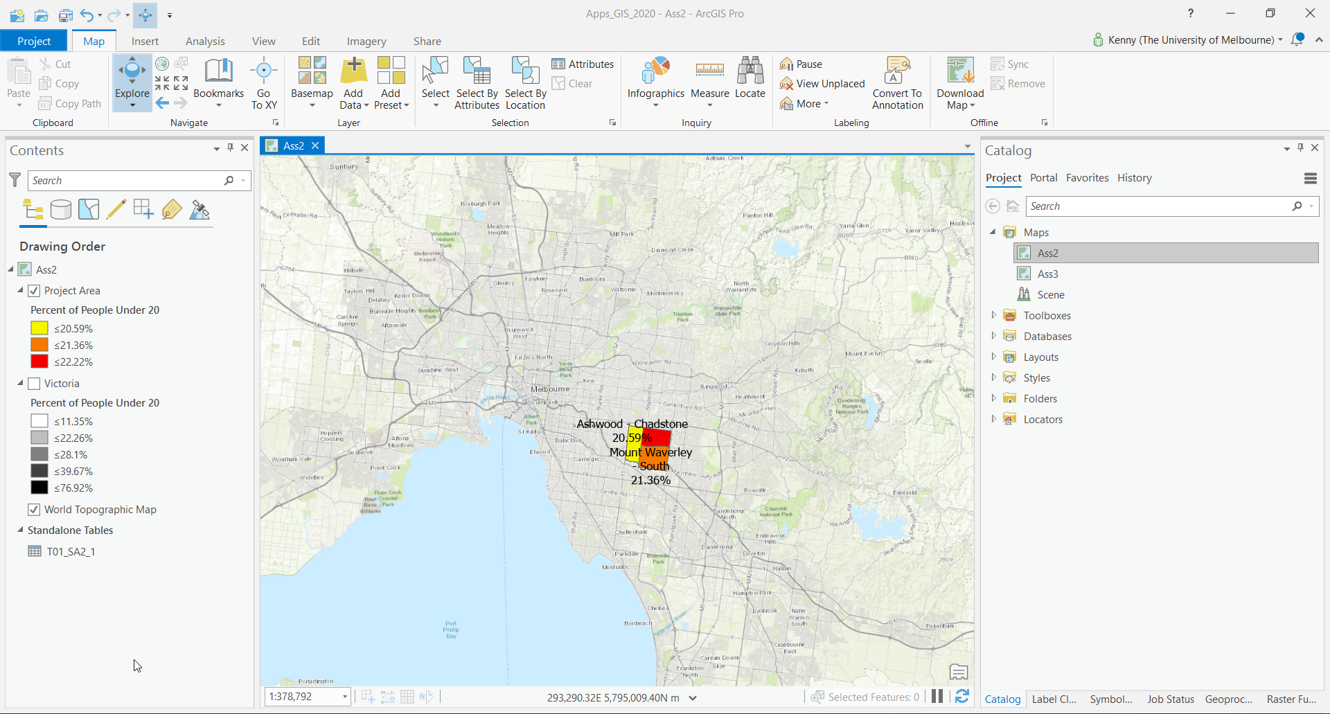
Demo of ArcGIS Pro
Introduction

Slide 12
Assignment 1
Online Tutorials
Really good tutorials and will cover a lot of the skills you need for ALL assignments.
These modules can be found by entering each module name into the search function at https://www.esri.com/training/catalog/search/
Exercise modules:
3 Core Modules: | ArcGIS Pro Basics
Getting Started with ArcGIS Pro | (upload final 2D-map, PDF)
Displaying Raster Data in ArcGIS (*Pro) (certificate)
Additional Modules: Processing Raster Data using ArcGIS Pro (certificate)
Distance Analysis using ArcGIS Pro | (certificate)

